Slide 1
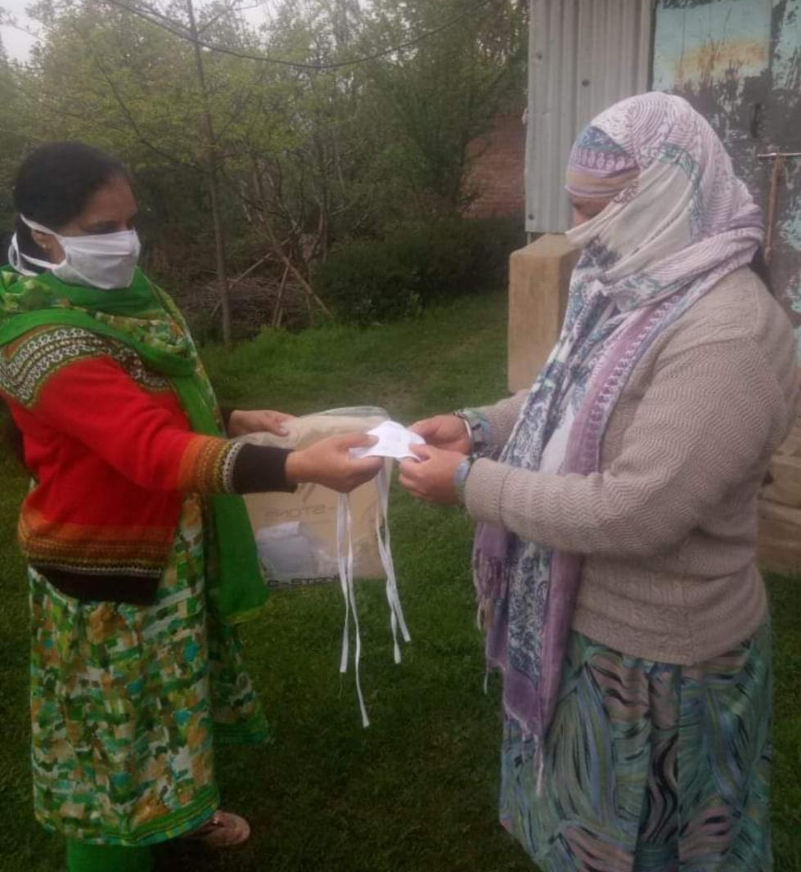
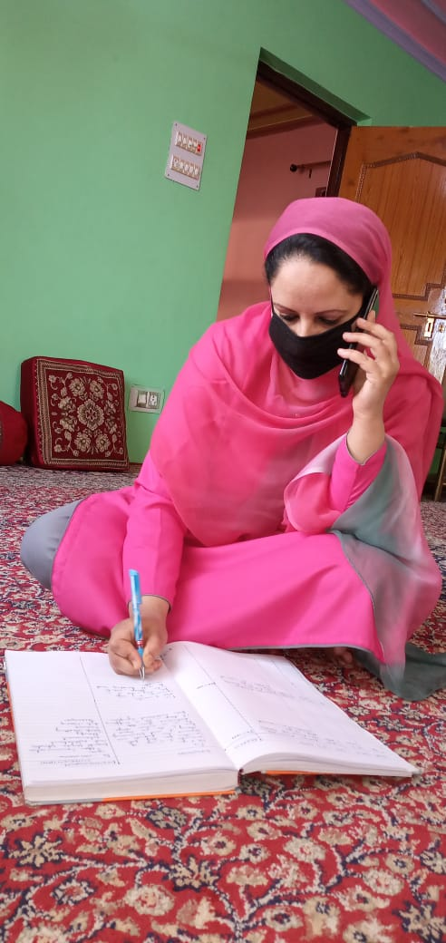
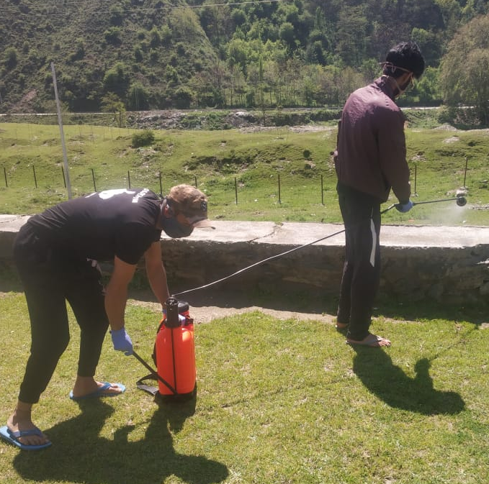

Fight Against COVID-19

Slide 2
CURRENT SITUATION
The whole world is under the grip of COVID-19, India has also been severely affected and is currently under lockdown with the cases rising every other day.
Our country has a huge population and the lockdown has affected many in various ways. Now the situation has
come up to the point where the world needs to
learn to live with COVID-19 and fight it with
togetherness.
During such times the call for swift response
becomes the priority as a lot of people are dealing
with mental and emotional crisis.

Slide 3
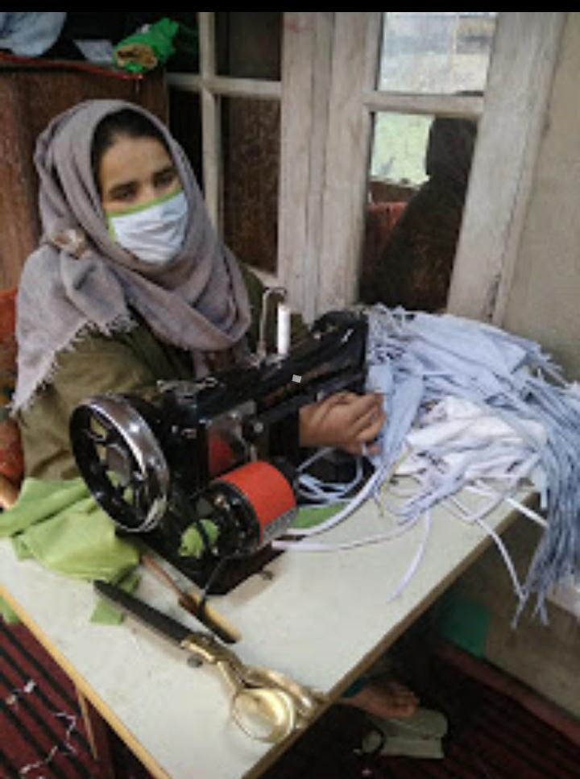
PROJECTS
The Indian Army in Baramulla, Kashmir, in partnership with NGO – REACHA (www.reacha.org) has trained more than a 1000 youth in livelihood activities since 2016 as part of their efforts to wean them away from militancy and now the unprecedented pandemic, COVID-19 is creating considerable problems for the local communities, therby posing a huge challenge to the army.

Slide 4
PROJECTS
The Army has been working closely with ONGC to support their projects. Genpact/Nasscom Foundation started support of a Cell for Livelihood Enhancement from 2018. REACHA is the implementing NGO. Training center is called Chinar 9 Jawan Club (C9JC), Baramulla::
Drug De-addiction Project
Livelihood Training Fashion Design
Retail & Hospitality Trades
Culture & Music Project

Slide 5
01
02
03
Mask Making
Sanitization Drive
Counselling
04
05
Music and Art
Essential Items
EFFORTS TO HELP THE COMMUNITY

Slide 6
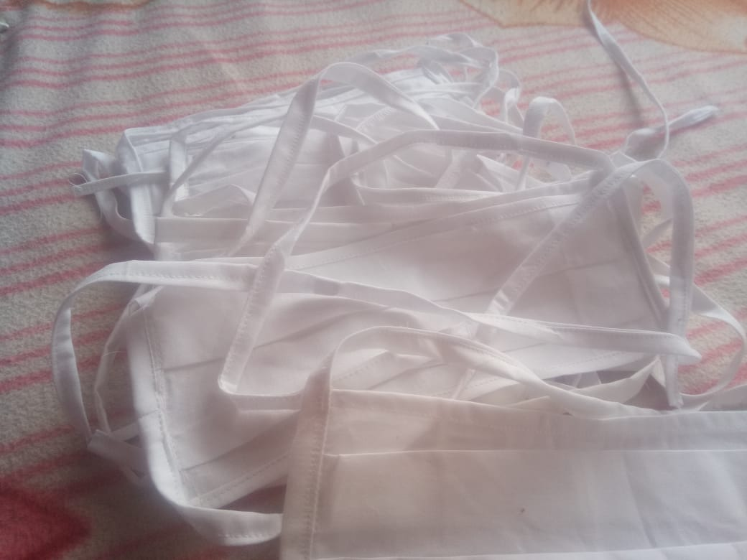
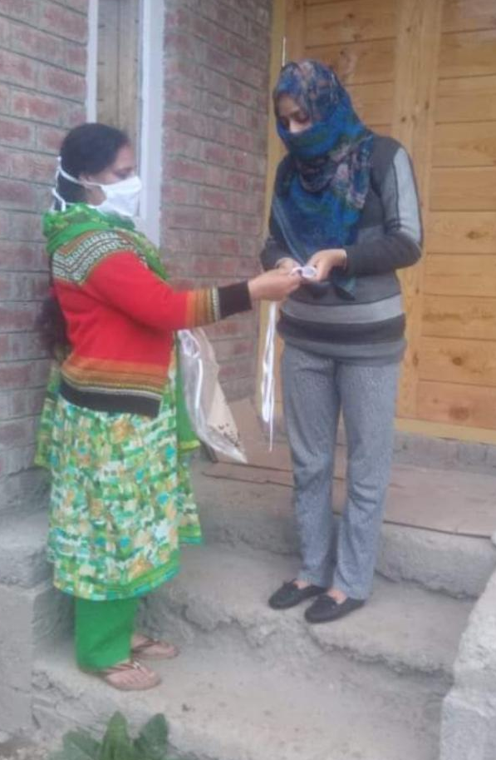
MASK MAKING
Cash support was provided to the Self Help Group developed by Chinar 9 Jawan Club, Baramulla - being run under the Indian Army supervision which was then used to buy raw materials for making masks.
Under the Livelihood training fashion design, Ms. Harmeet Kaur and her team are making 30 reusable masks daily which are being distributed free of cost in the community.

Slide 7
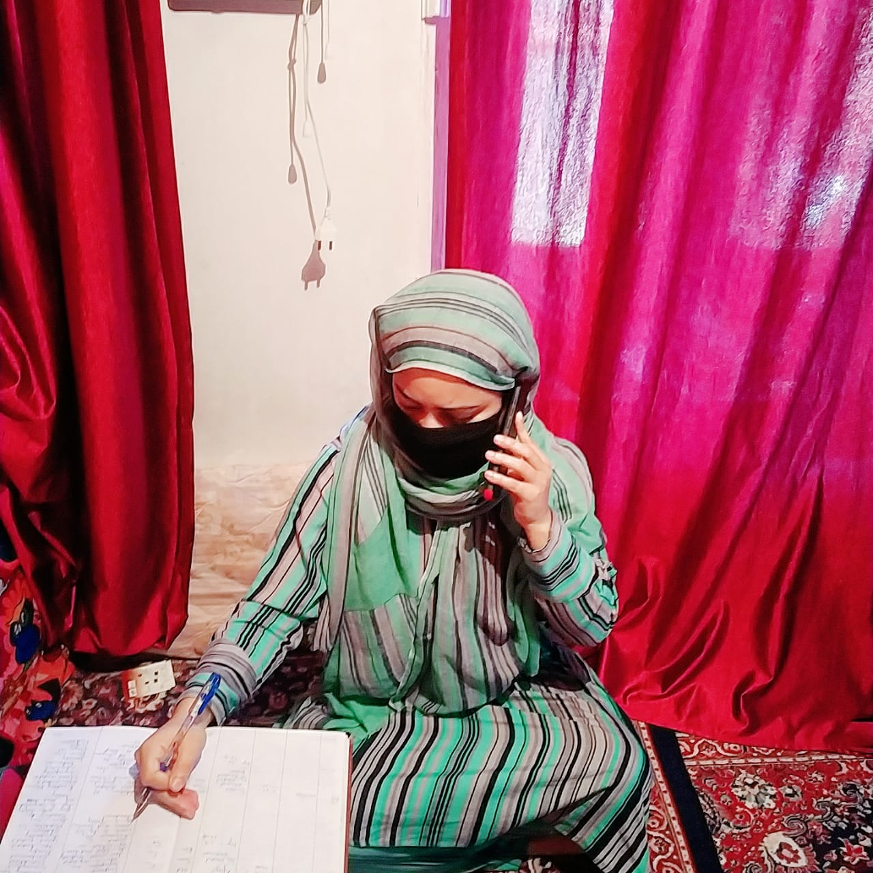
During such time not only physical health is getting affected but emotional and mental health also, ONGC is helping to strengthen army’s effort to support communities in Baramulla.
The ONGC supported Drug De-addiction Project housed within Army campus in Baramulla has been providing online and telephonic counselling sessions to the people who are suffering due to anxiety and nervousness evoked by lockdown.
COUNSELLING

Slide 8
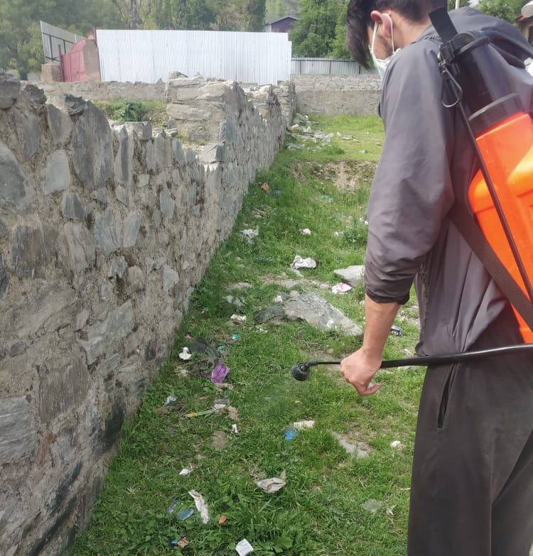
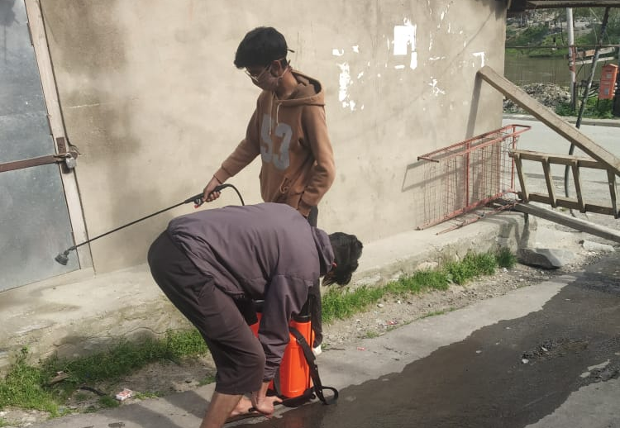
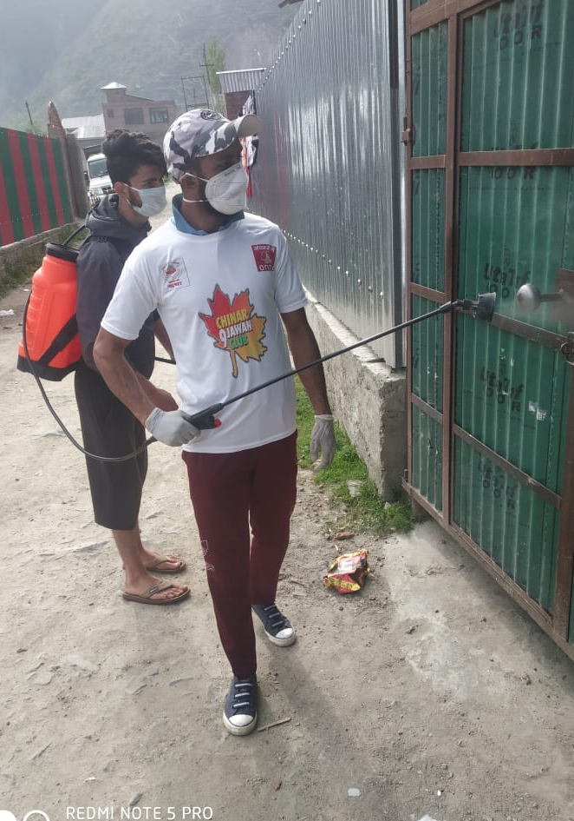
SANITIZATION DRIVE
Indian Army has been conducting constant sanitization drives in Kashmir to battle this pandemic.
Sanitization is an integral part to fight COVID-19 which helps in spreading awareness among people and eliminating the virus too.
Volunteers from C9JC helped Army in the sanitization drive to contribute their bit towards the society.

Slide 9
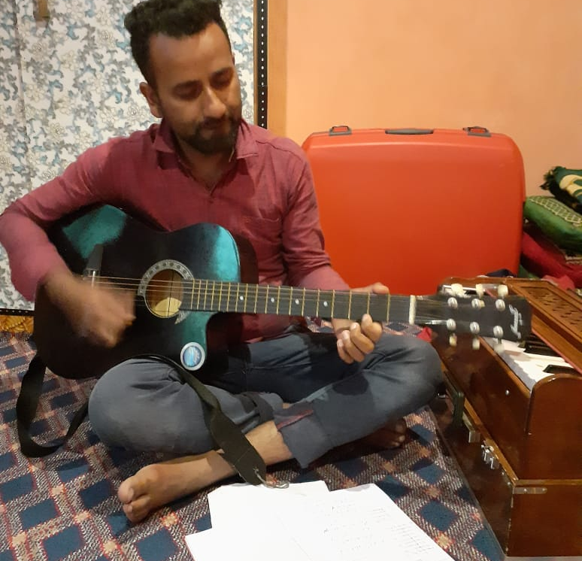
One of the best ways to deal with stress is to follow some hobby and listening to music.
Mr. Tariq Rasool, the trainer of art and culture domain thought of an idea and started online classes in Kashmir where he along with his students has composed many coronavirus songs which are helping people to cope with the situation and making them aware about it.
MUSIC STRESS BUSTER

Slide 10
Thank You
The Indian Army has been involved in all these projects along with ONGC and REACHA for the betterment of the people pf Kashmir.
Even during the tough times of COVID-19 when the whole world is suffering, the army is trying its best to reach out and support the people to stay safe and healthy.

